Slide 1
Presentation by
Muhammad Raees (mr2714@rit.edu)
Asya Vitko (av8258@rit.edu)
Project 4
PCA and Classification

Slide 2
Overview
We implemented dimensionality reduction upto 300 eigenfaces with
Eigenvalue Decomposition PCA
Singular Value Decomposition (SVD)
Image Reconstruction at different eigenfaces
25 to 300
Face Recognition and Identification.
Linear Classification
K-Nearest Neighbors

Slide 3
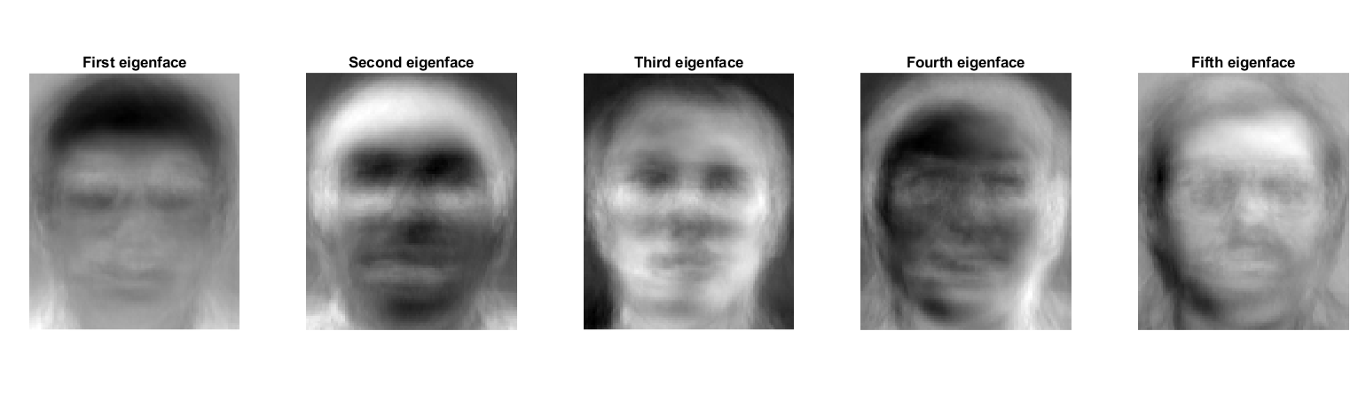
PCA - Leading Eigenfaces as an Image
First 5 PCs, N=400

Slide 4
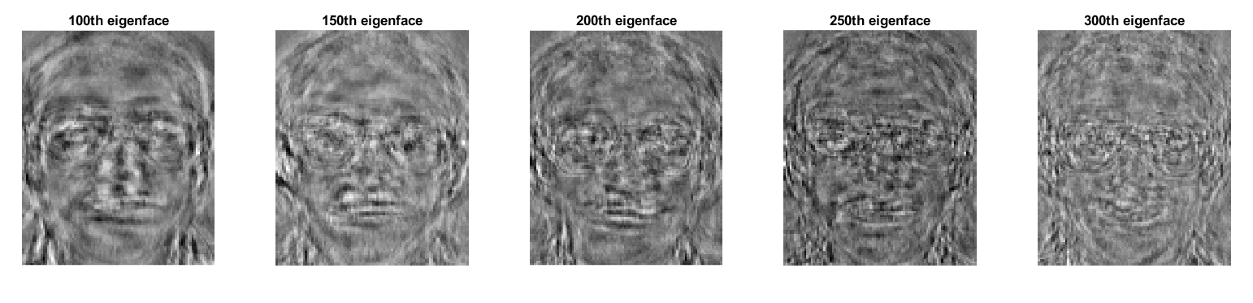
PCA - Importance of Eigenfaces
5 Not leading PCs, N=400

Slide 5
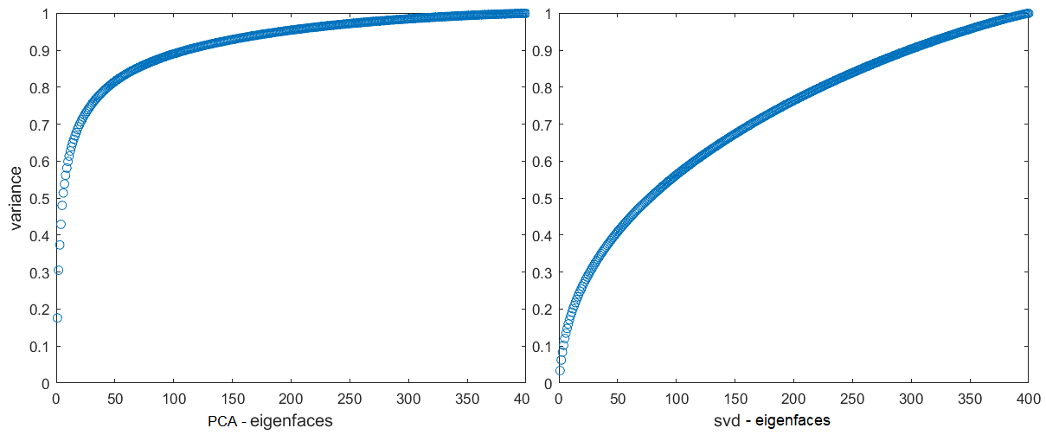
PCA/SVD - Importance of Eigenfaces
Cumulative Variance - Contribution, N=400

Slide 6
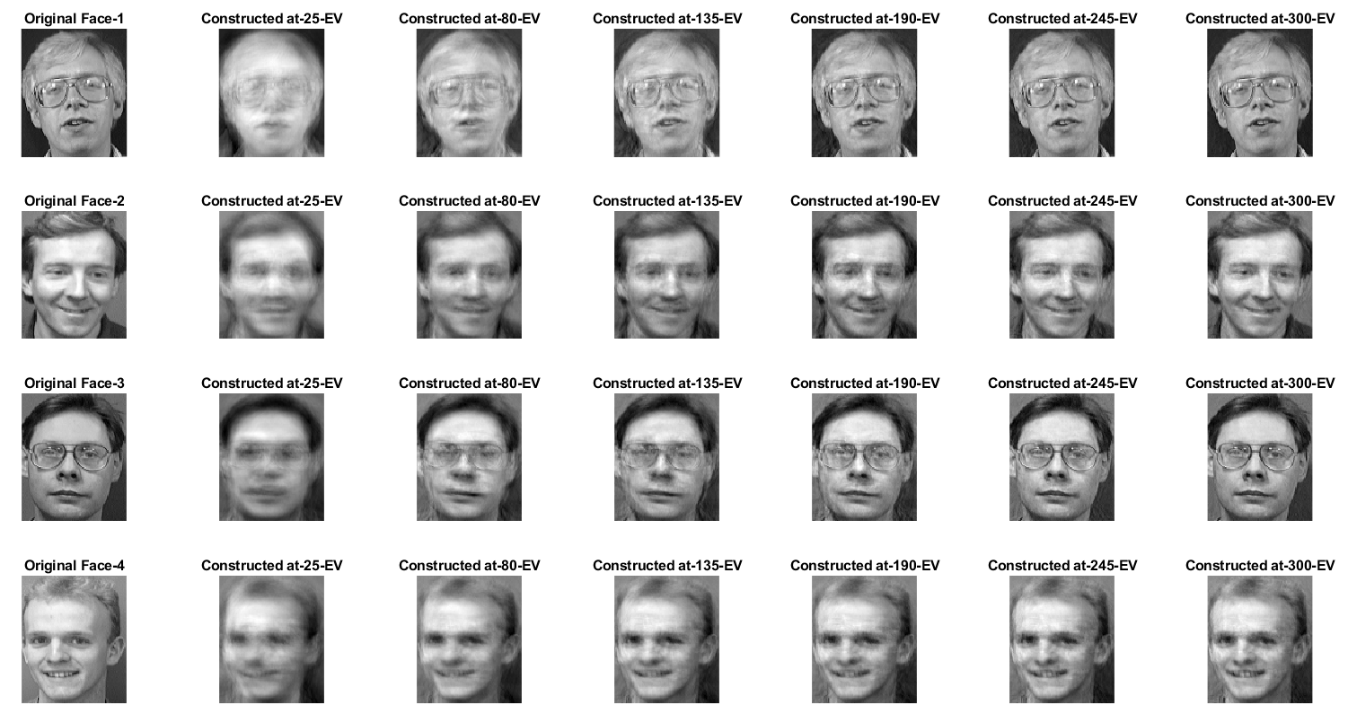
Image Reconstruction
Cumulative Variance - Contribution, N=400

Slide 7
Reconstruction Error
Cumulative Variance 90-95%, N=400
Qualitative Observation, N=400

Slide 8
Face Recognition and Identification
The dataset is divided into training and testing
Training - 35 subjects and 8 images per subject.
Testing - 2 images for each of the 35 subjects.
Testing - 10 images for each of the 5 subjects.
Testing - 15 non-face images for recognition task.
For face classification, we as well do
Train PCA on N=280 images
Test on 70 (35x2) representative images.
Report the accuracy.

Slide 9
Face Recognition
For face recognition, using linear and KNN
Train PCA on N=280 images
Transform test data to PCA space
Test on 120 test set face images, and 15 "non-face" images. N=135
Report the accuracy.
The linear method gives a positive confidence score if it recognizes an image as a face.
We used a max threshold distance between the neighbors to recognize face and non-face images.

Slide 10
Face Identification
For face identification, using linear and KNN
Train PCA on N=280 images
Transform test data to PCA space
Test on N=120 and reduced N=70 test set face images
The linear method provides confidence scores for 35 classes of faces.
We used a max threshold distance between the neighbors to identify/differentiate face classes.
Sr. | Method | Recognition Accuracy | Classification Accuracy | Classification Accuracy – Reduced
1 | Linear Classification | 60% | 53% | 91%
2 | K-NN | 89% | 56% | 96%

Slide 11
Conclusion
The leading eigenfaces contain informative face features - hairs, eyes, nose, chin, etc.
Leading 47 eigenfaces represent around 80% of total variance, around 110 represent 90% or so.
Optimal reconstruction error range can be chosen by examining variance and images visually.
Face identification task is low on accuracy, other methods, feature expansion or basis expansion could be experimented.

Slide 12
Thank you!
Questions?

